Slide 1

UIDAI Hackathon
Team Reference ID : muMLI4v9xL
Team Hephaestus Member Details
SI NO | NAME | EMAIL ID
1 | THARUN KUMAR C | 20eumt080@skcet.ac.in
2 | KESHAV B | Keshavbas291@gmail.com
3 | UDAYASRI S | udayasriswamikannan2002@gmail.com
4 | SIMON JOSE | 20eumt070@skcet.ac.in
5 | LALITH SHANKAR S | 20eumt035@skcet.ac.in

Slide 2
ABOUT THE PROBLEM STATEMENT
THEME : ADDRESS UPDATE
PROBLEM STATEMENT : ADDRESS FORMATTING ISSUE
● Often Address in Urban Area Contains Repetition of Texts
○ Example : damaravancha, gudur mandal, Damaravancha,
Dameravancha, Warangal, Andhra Pradesh-506134
● De-Clutter the Address
○ Identify Repetitive Constituents
○ Merge and Format the Address
● Develop the API which will undertake Address Formatting
○ Accepts the Address in Raw Form (English and Local Language Address)
○ Formats the Address and Presents as an Output

Slide 3
APPROACH
We have come up with an idea that will provide this problem a solution which will be simple yet an effective one. This problem can be solved by comparing the contents in each field of the record with each other of the same and if any repetitions detected, it will be amalgamated.
The programming language that will be used to build the program for the above mentioned solution is Python 3.

Slide 4
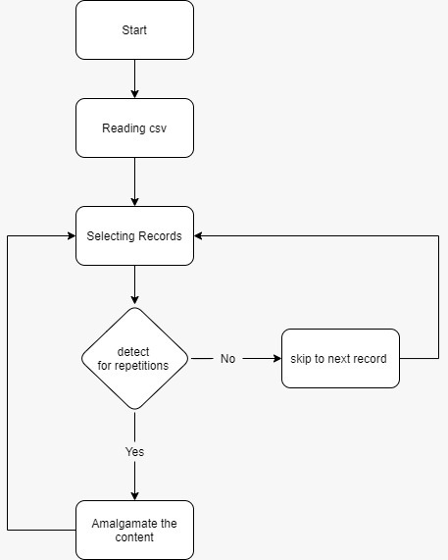
ARCHITECTURAL DIAGRAM

Slide 5
API USAGE
> Aadhaar EKYC API

Slide 6
SECURITY CONSIDERATIONS
Security and Fraud Prevention Considerations :
Since this is just an update to database there is no need for additional security considerations or fraud prevention.

